Slide 1


Analysis on Social Buzz

Slide 2


Today's agenda
Project recap
Problem
The Analytics team
Process
Insights
Summary

Slide 3

Social Buzz is a fast growing technology platform that needs to
adapt quickly to its global scale.
Accenture has started a 3 months POC to focus on 3 tasks such as:
An audit of their big data practice
Recommendations for a successful IPO
An analysis of Social Buzz content categories that highlights the top
5 categories with the largest aggregate popularity
Project Recap

Slide 4


Thousands of post everyday. How can we capitalize on so much data being generated
Analysis on how to find the Top 5 most poplar category of content.
Problem

Slide 5
Process
1
Data Understanding
2
Data Cleaning
3
Data modelling
4
Data analysis
5
Generate insights

Slide 6

Insights
There are 16 unique categories
There 1,897 reactions to the Animals category
May is the month with the most posts.

Slide 7
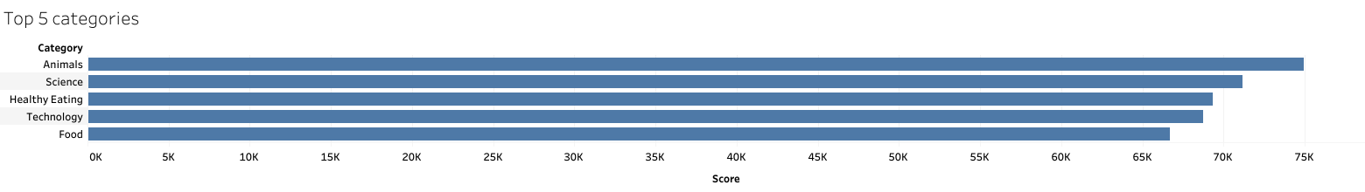

Slide 8
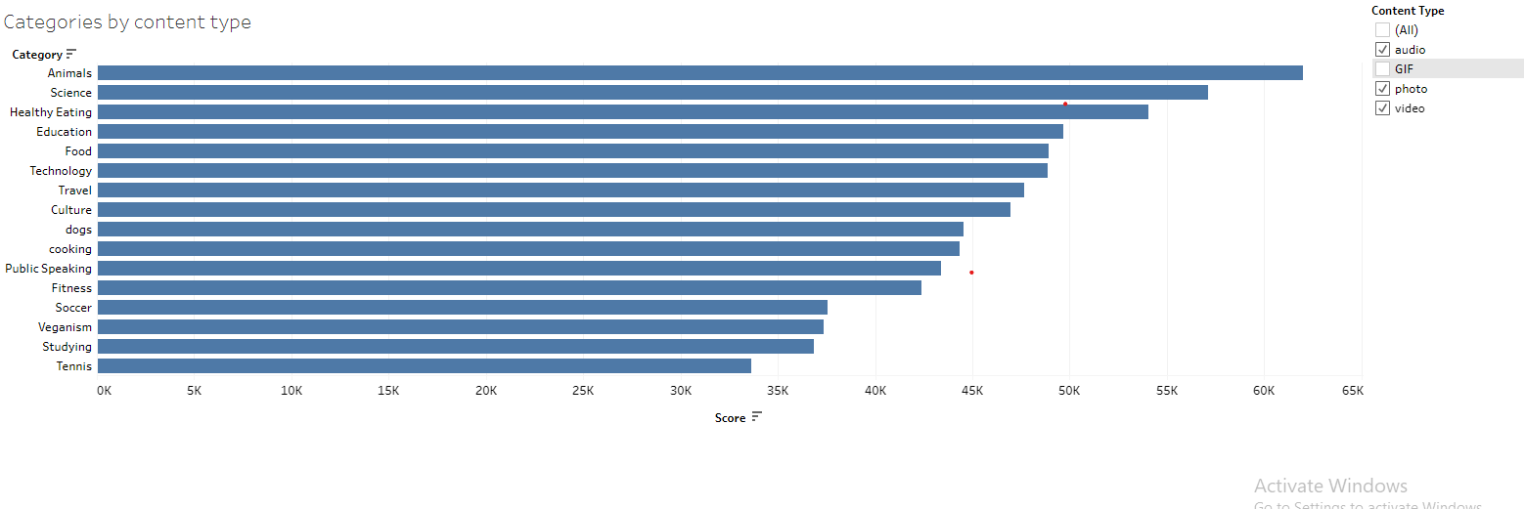

Slide 9

Analysis
Animals and Science are the two most popular form of content. This shows that most people on the platform prefer content that is informative or that is factual.
Insights
Content that gears towards food such as healthy eating ranking high
and food coming 5th seems to perform really well. Therefore the company create campaigns that are geared towards healthy eating lifestyle to raise engagement.
From the analysis we can see that when content is consumed by traditional forms of media such as audio, video, and pictures. The popularity in the categories remain the same but when looking at non-traditional forms of media such as GIFs there is a shift.
Food related content such as cooking and food are in the top 5. This means that healthy eating can gain popularity in this form of content type if more was generated.
Summary

Slide 10

Thank you!
ANY QUESTIONS?

